Slide 1

QuickBazaar An Online Marketplace
Group Members:
Name: Rafidul Islam ID: 1912152642
Name: Md Rafin Al Zhehad ID:1911626642
Name: Md. Riyad-Ur-Rahman ID:1911125642

Slide 2
Introduction
The main goal of an e-commerce website in Bangladesh is to provide a platform for businesses to sell their products or services online to consumers in the country. Our website is designed to be user-friendly, easy to navigate, and provide a seamless shopping experience for customers.
Building an e-commerce website in Bangladesh can provide businesses with the opportunity to reach a larger customer base, increase revenue, and grow their business through a cost-effective and convenient platform.
In our project, we want to keep variety of products. Most notably, Bangladesh lacks an online marketplace for the sale of agricultural goods. These products will be highlighted on our website.

Slide 3
Design and Methodology
Define target audience: Identify who is our target customers are and what their needs and preferences are. This will help in tailor our website and marketing efforts to effectively reach and engage them.
Research our competitors: Analyze the websites of our competitors to understand their products, pricing, and marketing strategies. This will help us in identify our opportunities and differentiate your website.
Plan the structure of our website: Determine the categories and subcategories of products or services we will offer, and how they will be organized on our website. Consider including filters and search functionality to make it easy for customers to find what they are looking for.
Integrate payment options: We will use a payment gateway to enable secure online transactions on our website.
Monitor and optimize: Once our website is live, we will monitor its performance and gather feedback from customers. Use this information to make improvements and optimize our website to better meet the needs of your customers.

Slide 4
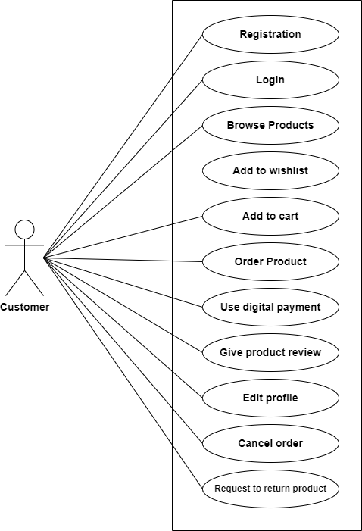
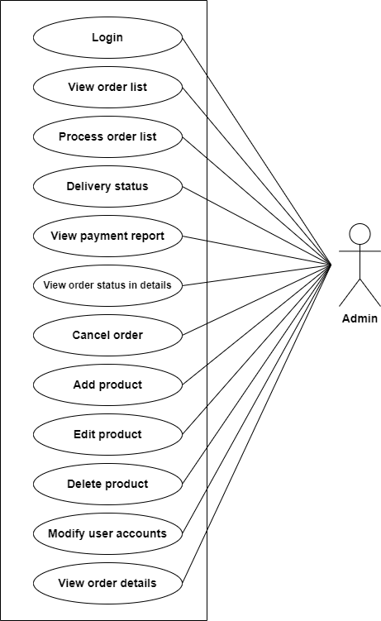

Visual Aids
UML Use Case Diagram
4

Slide 5
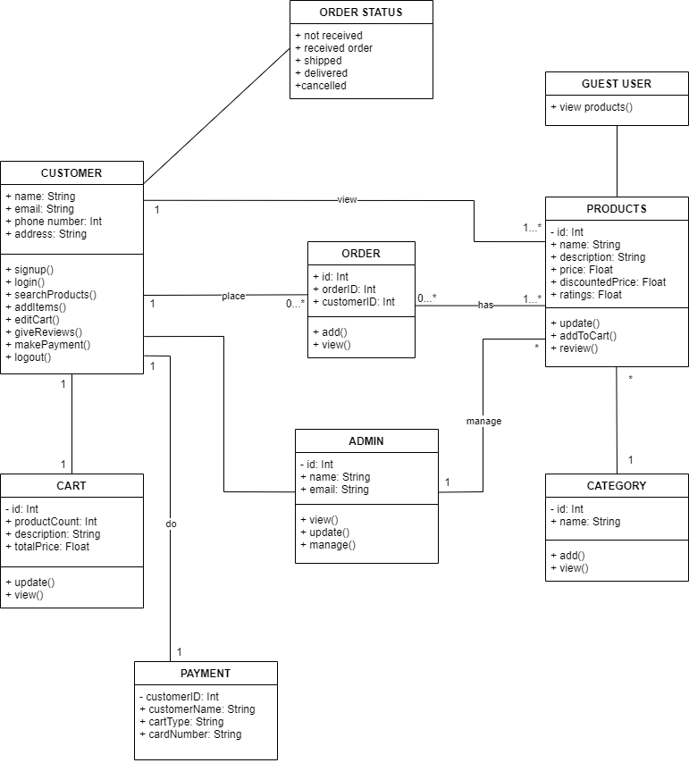
Visual Aids
UML Class Diagram

Slide 6
Economic Impact
Economic growth: By providing a platform for businesses to sell their products or services, an e-commerce website can contribute to economic growth in Bangladesh by increasing the volume of online transactions and boosting consumer spending.
Increased competitiveness: An e-commerce website can help businesses in Bangladesh increase their competitiveness by offering an online sales channel that allows them to reach a wider customer base and compete with larger, international retailers.
Improved access to international markets: An e-commerce website can also provide an opportunity for Bangladeshi businesses to reach international customers and participate in the global marketplace.

Slide 7
Ethical and Professional Responsibility
There are several ethical and professional responsibilities to consider when building an e-commerce website in Bangladesh
Protecting consumer privacy: It is important to ensure that the personal information of your customers is protected and not shared without their consent. This includes complying with relevant privacy laws and implementing measures.
Ensuring the security of online transactions: It is essential to implement measures to ensure the security of online transactions, such as using secure payment gateways and implementing measures to prevent fraud.

Slide 8
Tools and Technologies
We used a varieties of tools and technologies to conduct this experiment. They are
Listed below:
Frontend : React JS, HTML, CSS, Tailwind CSS
Backend : Express JS, Node JS
Database : Mongo DB
API testing : Postman

Slide 9
Results
User View
Landing Page: The goal of a landing page is to convert visitors into customers by presenting them with a clear and compelling call-to-action (CTA) that encourages them to take a specific action, such as making a purchase or signing up for a newsletter.
Product category: An e-commerce web application typically includes a product catalog that displays the products available for purchase, along with details such as images, descriptions, and pricing.
Product Details: The product details function of an e-commerce website is a feature that allows customers to view detailed information about a specific product. This typically includes information such as the product's name, price, images, description, and any available options or variations (such as size or color).

Slide 10
Results
User View
Sign up-Sign in: The sign-up and sign-in features of an e-commerce website are typically used to create and manage customer accounts. Customers who create an account can save their shipping and payment information for future purchases, view their order history, and access other account-specific features.
Shopping cart: A shopping cart function allows customers to select products they want to purchase and keep track of them as they shop. The shopping cart typically includes options for adjusting the quantity of items and calculating the total cost.
Search Bar: The search function of an e-commerce website is a feature that allows customers to quickly find products they are looking for on the site. This is typically accomplished through the use of a search bar, where customers can enter keywords or phrases related to the product they are looking for.

Slide 11
Results
Admin View
The admin section is inaccessible to anyone without a login. In the admin dashboard, we have finished the part where we created products and categories.
So far, we have completed these tasks for our project. Later, the remaining portion will be completed.

Slide 12
Thank you!

